Slide 1


Digital Portfolio
STUDENT NAME: S.MOTHISH
REGISTER NO AND NMID: 24H243 &
B9B015B64247228A1A342B95CDEBE8F9 & asunm1301212402388 & 212402388
DEPARTMENT: BCA
COLLEGE: AM JAIN COLLEGE
1

Slide 2

DIGITAL PORTFOLIO
2

Slide 3




AGENDA
1.Problem Statement 2.Project Overview 3.End Users 4.Tools and Technologies 5.Portfolio design and Layout 6.Features and Functionality 7.Results and Screenshots 8. Conclusion 9.Github Link
3/21/2024 Annual Review
3

Slide 4


PROBLEM STATEMENT
Creating apersonal digital portfolio
to showcase skills, projects, and contact details in a visually engaging and professional manner. Many developers struggle to present their work effectively; this portfolio solves that by combining creativity with functionality.
4

Slide 5

PROJECT OVERVIEW
The portfolio is a responsive, neon-themed website built by S. Mothish, highlighting skills, projects, and design aesthetics. It demonstrates expertise in modern web development, interactivity, and UI/UX principles.
5

Slide 6

WHO ARE THE END USERS?
Recruiters and hiring managers looking to assess skills. Potential clients seeking web design/development services. Collaborators or peers interested in creative digital projects.
6

Slide 7

TOOLS AND TECHNIQUES
HTML5 CSS3 (custom neon theme, animations, responsiveness) JavaScript (interactivity, hamburger menu, sparkle button effect, smooth scrolling) Font Awesome (icons for projects and social links)
7

Slide 8

POTFOLIO DESIGN AND LAYOUT
Header & Navigation: Fixed header with responsive hamburger menu. Hero Section: Bold name, tagline, and animated button with sparkle effect. About Section: Split layout (text + placeholder image), with highlighted skills. Projects Section: Grid layout showing project cards (Portfolio, E-Commerce, Interactive Game). Contact Section: Form and contact details (email, phone). Footer: Social media links and copyright.
8

Slide 9
FEATURES AND FUNCTIONALITY
Responsive designfor desktopand
mobile. Interactive hamburger navigation menu. Sparkle animation button effect. Smooth scrolling navigation. Animated neon-glow text effects. Project showcase with hover effects. Contact form for user interaction.

Slide 10
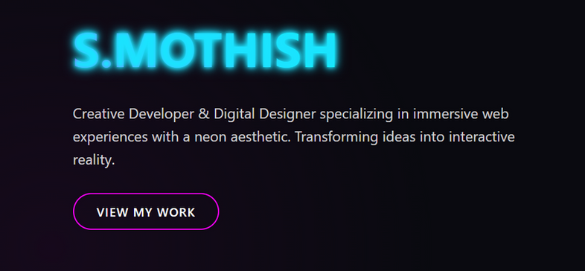
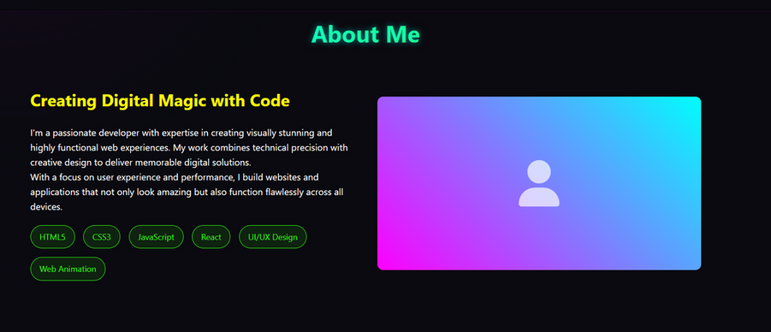
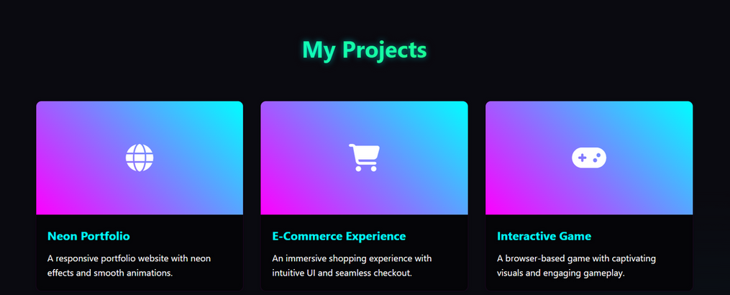
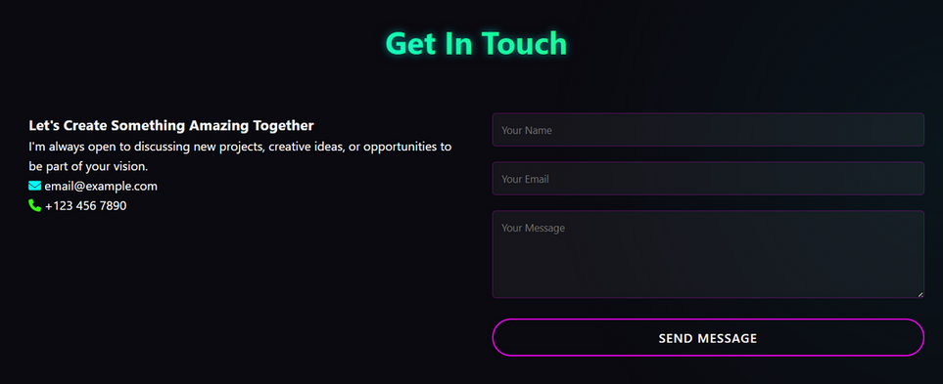
RESULTS AND SCREENSHOTS
3/21/2024 Annual Review
10

Slide 11
CONCLUSION
The portfolio successfully showcases technical skills, creativity, and design expertise. It not only provides a platform for self-presentation but also enhances visibility to recruiters and clients. With interactive effects and responsive design, it creates a strong digital presence.
11

Slide 12
https://24h243-create.github.io/mothish/

